Slide 1

VSafe Route Project
Govhack
8 septemper 2024
Notes:
Hi, our project for GovHack 2024 is Vsafe Route

Slide 2
Hack in Action

Slide 3
The benefits could achieve
Data-Driven Decision Making
Crash Hotspot Identification
Feedback Processing
Evidence-Based Policy Recommendations
Increased User Participation
Improved Health and Wellbeing

Slide 4
Fed Tech Team
Nitipat
Tristan
David
Tanmoy

Slide 5
Data Reuse Story
Victoria Crash Data combined with Principal Bicycle Network (PBN) data to improve cycling safety and infrastructure.
By integrating these datasets with real-time spatial data and multi agent AI-based web applications, our team identified high-risk routes for cycling
This insight led to targeted infrastructure modifications, improving cyclist safety and promoting cycling as a sustainable transportation option.
Reusing existing data enabled efficient, data-backed decisions without needing new data collection.

Slide 6
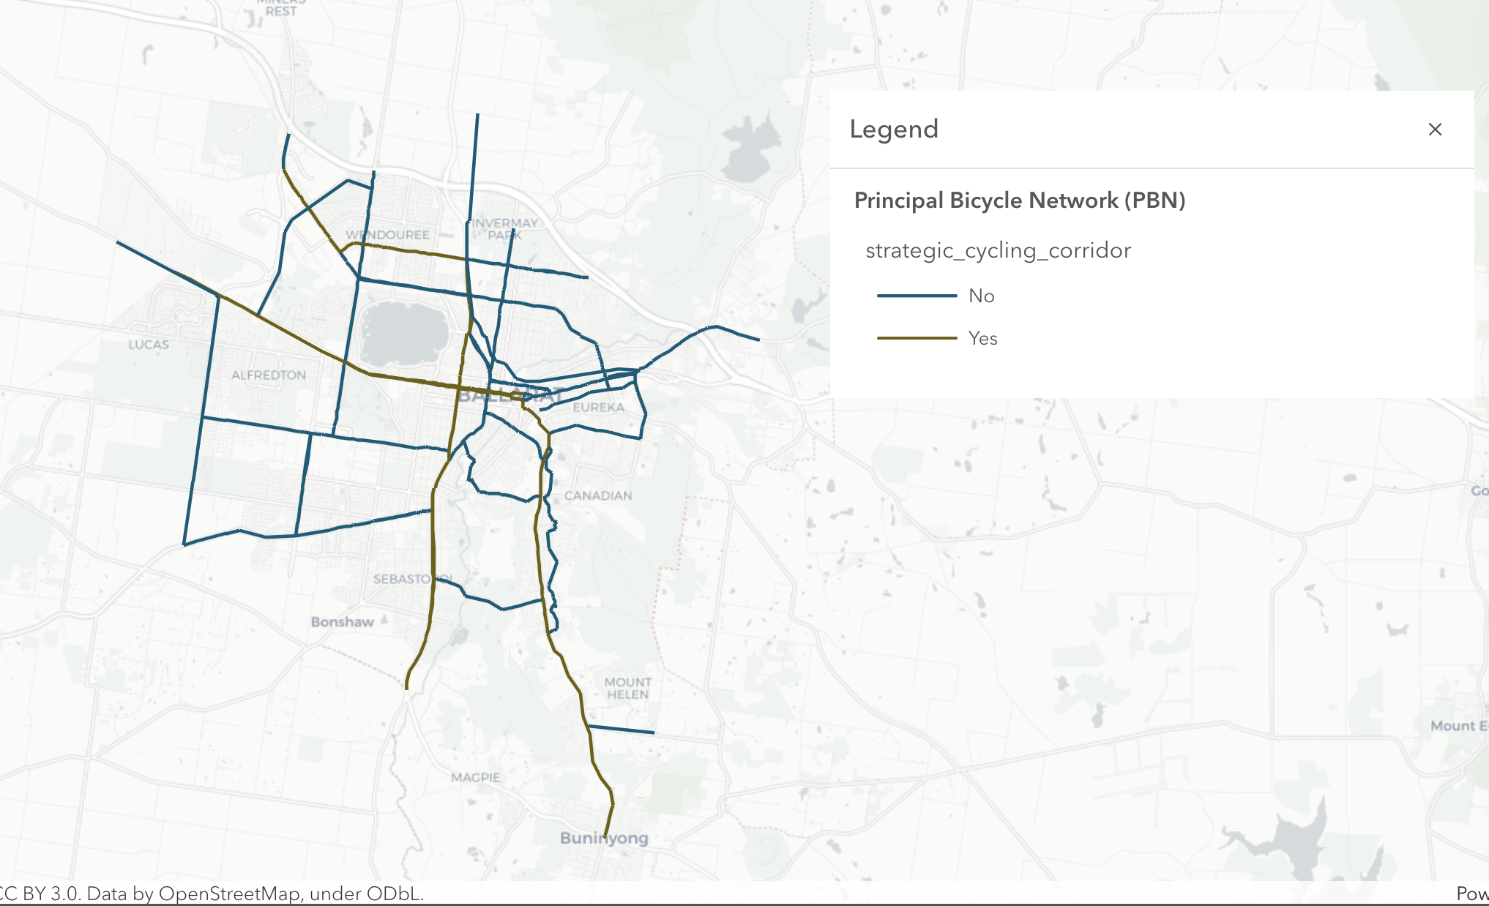
Data Used - Principal Bicycle Network (PBN)

Slide 7
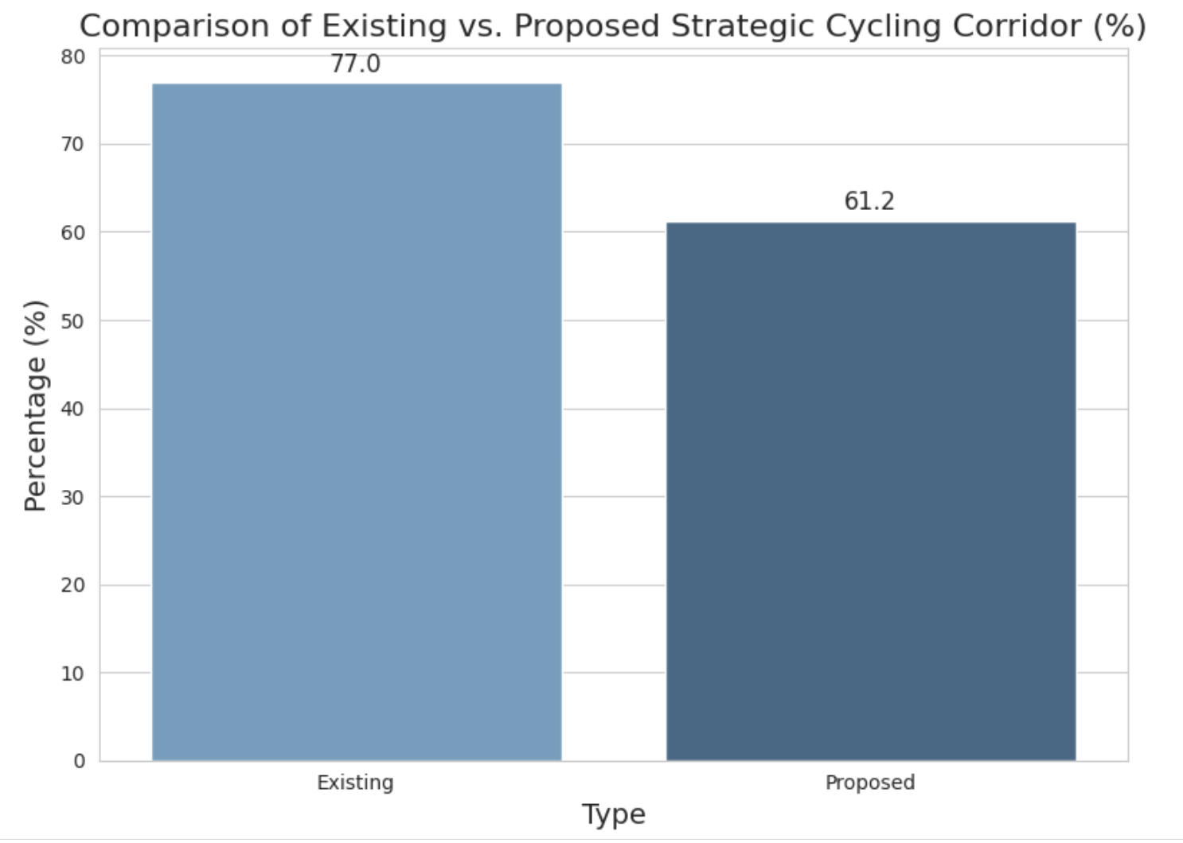
Trends in Strategic Cycling Corridor
The government is decreasing
the Strategic Cycling Corridor
in the Victoria routes

Slide 8
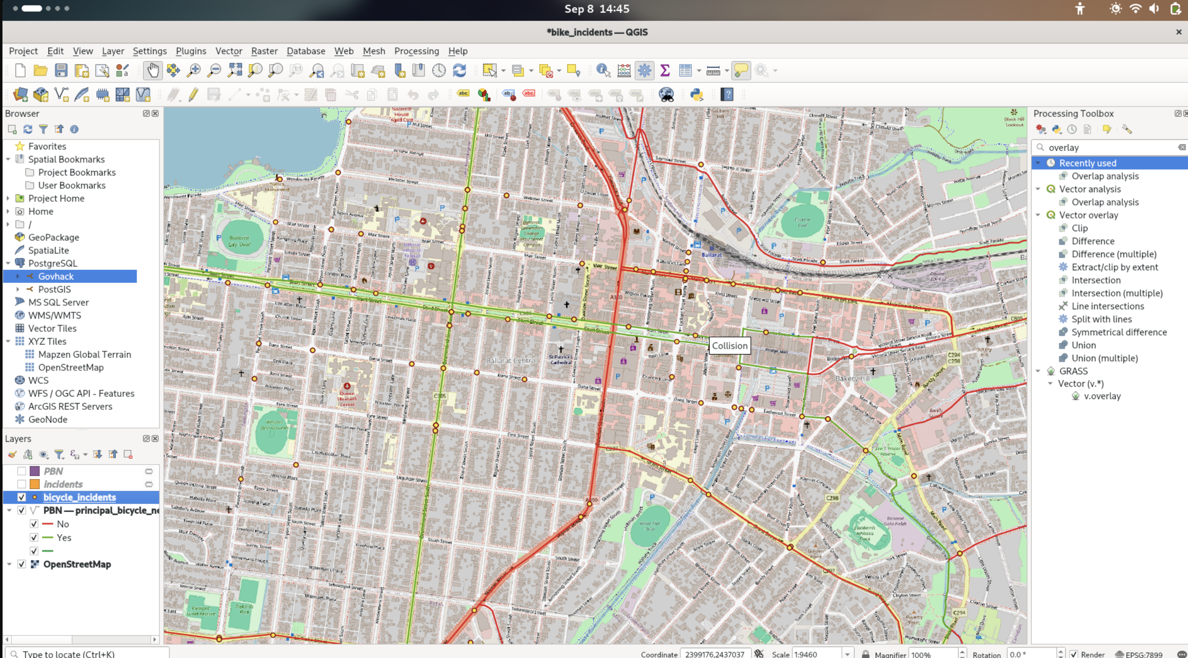
Spatial Data Map

Slide 9
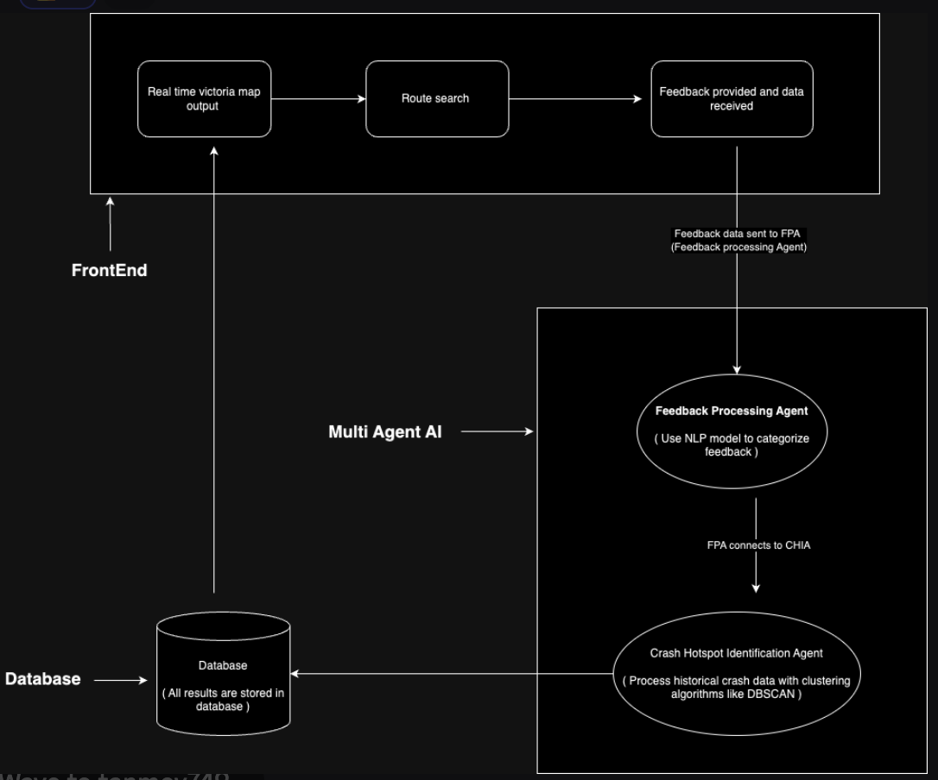
Multi Agent AI System Design

Slide 10

Call to Action
What are the key things you want your audience to come away with?
What it is it you want your audience to do with what they have learned?

